Slide 1
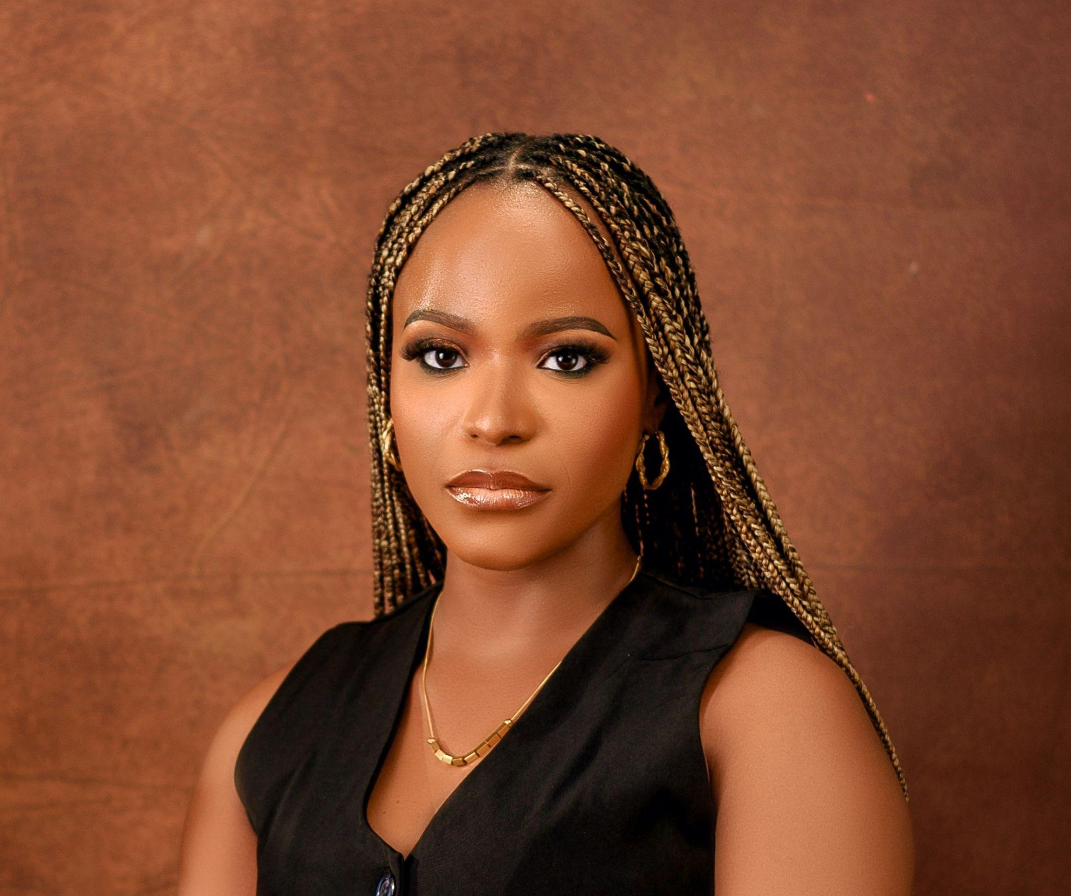
Understanding Web
Development
Essentials
Exploring the intricate dynamics of web’s client server model and enhancing my understanding of web technologies
Ebunoluwa Arimoro

Slide 2
How Does The Web Work?
Client-Server Model
HTTP/HTTPS Protocols
Domain Name System
The web operates on a client-server model where a client, usually a web browser, initiates a request for information from a server. The server then processes this request, retrieves the necessary data, and sends back the requested web page to the client, which is then rendered visually for the user.
HTTP (Hypertext Transfer Protocol) and HTTPS (HTTP Secure) are the foundational protocols for communication on the web. They dictate how messages are formatted and transmitted, enabling browsers to request and receive web pages securely.
DNS acts as the phonebook of the internet, translating user-friendly website names (like google.com) into machine-readable IP addresses that servers use to locate each other.

Slide 3
What Do You Need to Be a Web Developer?
Technical Skills
Soft Skills
Tools
I'm focusing on HTML for structure, CSS for styling, and JavaScript for interactivity. I also use Git & GitHub for version control and collaboration.
Beyond technical skills, I value problem-solving for debugging, creativity for design, and attention to detail for functionality. A growth mindset keeps me updated with industry trends.
To support my learning, I use VS Code for coding, Git & GitHub for version control, and Figma for UI design and prototyping. These tools help me code, collaborate, and refine designs efficiently.

Slide 4
Why Did I Choose to Learn Web Development?
Personal Motivation
I enjoy problem-solving and creating digital solutions.
The ability to build functional and visually appealing websites excites me.
Career Growth
Web development is in high demand and offers diverse job opportunities.
It allows for flexibility (remote work, freelancing, startups, etc.).
Passion for Innovation
I want to build websites that improve user experiences and make an impact.
Developing my skills in both frontend and backend to become a well-rounded developer.

Slide 5
Conclusion
Summary of My Learning So Far
The web functions through requests and responses between clients and servers.
A web developer requires a mix of technical and soft skills.
I chose web development because it aligns with my strengths and interests.
My Next Steps
Strengthening my knowledge in JavaScript and backend development.
Building small projects to apply my skills.
Learning more about frameworks like React.
Practicing GitHub collaboration and contributing to open-source projects.

